Slide 1

Capstone Project – I: Review – 2 on
Impact Ratio of Social Media/Al on the Youth
Presented by the Batch No. : 8
Ajit Kumar VU22CSEN0101245 (TL)
N.Lowkik Reddy VU22CSEN0100289
Bhanu Teja VU22CSEN0100662
Yarlagadda Venkatesh VU22CSEN0101120
Under the Guidance of
Dr. Yasoda Devi Gondi
Assistant Professor
Department of Computer Science and Engineering
GITAM School of CSE, GITAM (Deemed to be University),
Visakhapatnam.

Slide 2
CONTENTS
Recap of Capstone Project Introduction Review-1
  Problem Statement
  Objectives
  Feedback from Guide/Reviewers and actions taken after Review–1
Requirement Analysis
Identification of tools/technology/algorithms
Design Strategy (project workflow/ system design/ DFD/UML design)
Conclusion
References
‹#›

Slide 3
Problem Statement
Social media and AI are increasingly embedded in the lives of youth, shaping their mental health, productivity, and social interactions. While AI offers tools for early detection of mental health issues and peer counseling, it often lacks empathy, fairness, and real-world validation. Simultaneously, algorithm-driven platforms expose young users to biased content, misinformation, peer pressure, and harmful influences. Despite growing research across areas like mental health, counseling, and algorithmic risks, studies remain fragmented and fail to offer a comparative analysis of the overall impact. There is a pressing need to evaluate the relative influence—impact ratios—of social media and AI on youth, and to develop balanced counseling strategies that promote digital well-being while mitigating risks.
‹#›

Slide 4
Objectives
Analyze Social Media Impact
Evaluate how social media usage affects youth mental health, productivity, and social behavior.
Study AI Influence
Investigate the role of AI tools in peer-support and counseling for youth, including acceptance and preferences.
Identify Risks of Generative AI
Map psychological, behavioral, and social risks associated with Generative AI use by young people.
Extract Data-Driven Insights
Collect and analyze datasets (social media posts, surveys, chat transcripts) to quantify the impact ratio.
Provide Counseling Recommendations
Suggest targeted interventions and hybrid AI-human approaches to mitigate negative effects and enhance safe usage.
‹#›

Slide 5
Feedback from Guide/Reviewers and actions taken after Review–1
Feedback and Actions
Feedback from Guide/Reviewers
1. Earlier our research was limited to the Research papers.
2. Few mistakes were done in the presentation
3. Proper communication between guide and teammates.
Actions taken
1. We manually collected data from friends and our College.
2. We fixed them this time.
3. Ater review one everyone took initiatives and worked for a common goal which was to complete the project and help each other.
‹#›

Slide 6
Requirement Analysis
Hardware Requirements
Processor: Intel i5 or above
RAM: 8 GB+
Storage: 512GB SSD
Internet connection
Software Requirements
Windows 10/11 or equivalent
MS PowerPoint & MS Word
Web browser (Chrome)
PDF reader
‹#›

Slide 7
Identification of tools/technology/algorithms
Chat GPT / AI LLMs – used for summarizing research papers, extracting key points, and generating insights.
PDF Analysis Tools – for reading, extracting, and interpreting research paper content.
Microsoft PowerPoint / Word – for presentation and documentation.
Web Browsers (Chrome/Edge) – used to access arXiv, Google Scholar, and open-access research papers.
‹#›

Slide 8
Identification of tools/technology/algorithms
Artificial Intelligence (AI) – specifically Natural Language Processing (NLP) for understanding user behavior and mental health patterns from text.
Machine Learning (ML) – models applied in reviewed studies for classification of mental health conditions.
Deep Learning (DL) – neural network–based architectures for improved accuracy.
Generative AI (GAI) – models like ChatGPT, used in youth interactions and risk analysis.
Algorithmic Social Media Systems – recommendation systems, feed algorithms, and personalization engines used by platforms like Instagram, TikTok, and YouTube.
‹#›

Slide 9
Identification of tools/technology/algorithms
From Research Paper 1 (ML for Mental Illness Detection)
SVM (Support Vector Machine)
Random Forest Classifier
CNN (Convolutional Neural Network)
RNN/LSTM (Recurrent Neural Networks)
Transformer Models (BERT, RoBERTa) ← highest performance
Text Feature Algorithms:
  Bag-of-Words (BoW)
  TF–IDF
  Word2Vec / GloVe embeddings
‹#›

Slide 10
From Research Paper 2 (AI vs Human Peer Support)
No ML algorithm used
Uses:
  Statistical Analysis
  User preference modeling
  Thematic coding of youth responses

Slide 11
From Research Paper 3 (Generative AI Risks Taxonomy)
Qualitative coding algorithms
Taxonomy mapping
Hierarchical risk classification
Frequency Distribution Analysis
(Used for building the 6-family, 84-risk taxonomy.)

Slide 12
From Research Paper 4 (Psychological Impacts of Algorithmic Social Media)
Algorithmic Recommendation Systems
(e.g., content ranking, feed optimization)
Persuasive Technology Algorithms
(like notification triggers, engagement loops)
User Behavior Modeling
(how teens respond to attention-grabbing systems)

Slide 13
Team Research
Link to Google Form:
↓
Manually collected data from the college students and friends.

Slide 14
Design Strategy
Data Flow Diagram/ER Diagram
Research Papers
│
▼
[ Data Extraction ]
│
▼
[ Analysis & Comparison ]
│
▼
[ Impact Ratio Evaluation ]
│
▼
[ Counseling Suggestions ]
│
▼
Final Output (PPT)
‹#›

Slide 15
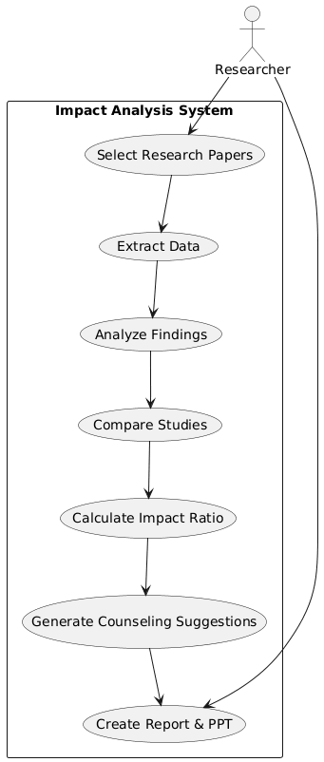
UML (Use Case DIAGRAM)

Slide 16
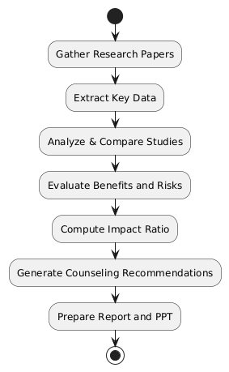
UML Activity Diagram (Project Workflow)

Slide 17
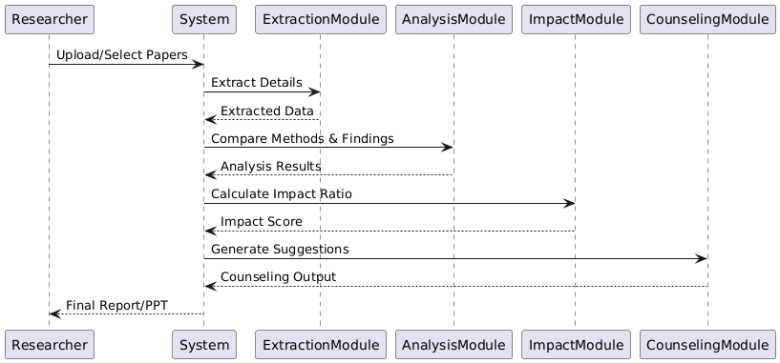
UML Sequence Diagram

Slide 18
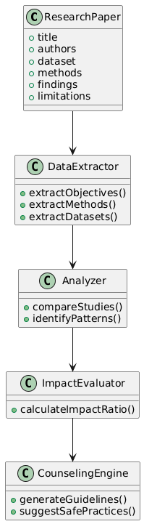
UML CLASS DIAGRAM

Slide 19
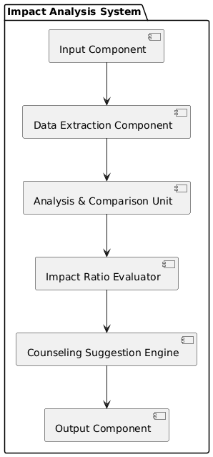
Component
Diagram

Slide 20
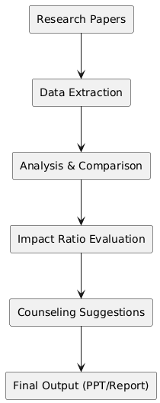
DATA FLOW DIAGRAM

Slide 21
Conclusion
The project is progressing smoothly, with key tasks such as literature review, data extraction, comparative analysis, and system design already completed. The team feels confident about finishing the remaining documentation and PPT work on time, as the project is research-based and well-organized. The expected outcome is a clear understanding of how social media and AI impact youth, along with practical counseling suggestions and a balanced evaluation of benefits and risks, which can help guide safer and healthier technology use among young people.
‹#›

Slide 22
References
Journals
Cao, S., Bian, J., Ji, X., & Zhang, Y. (2024). Machine Learning Approaches for Mental Illness Detection on Social Media: A Systematic Review. arXiv:2410.16204. https://arxiv.org/abs/2410.16204
Young, J., Liu, S., & Byrne, R. (2024). The Role of AI in Peer Support for Young People. CHI Conference on Human Factors in Computing Systems (CHI ’24). arXiv:2405.02711. https://arxiv.org/abs/2405.02711
Yu, L., Chen, B., & Shuster, K. (2025). Understanding Generative AI Risks for Youth: A Taxonomy and Escalation Pathways. arXiv:2502.16383. https://arxiv.org/abs/2502.16383
Arora, S., Krofta, M., & Jourová, V. (2024). The Psychological Impacts of Algorithmic and AI-Driven Social Media on Teenagers: A Call to Action. Dakota State University. (PDF uploaded by user)

